Slide 2
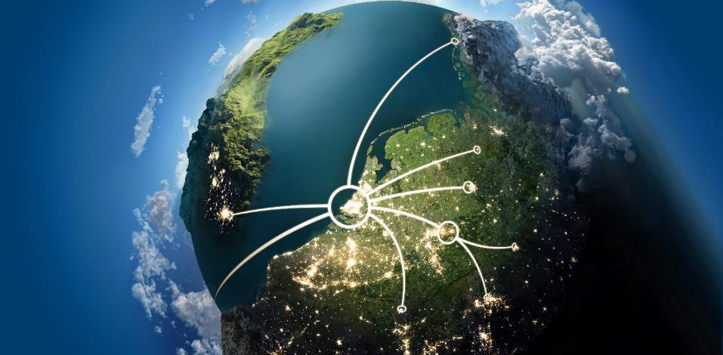
Container shipping ready for the future.

Slide 3
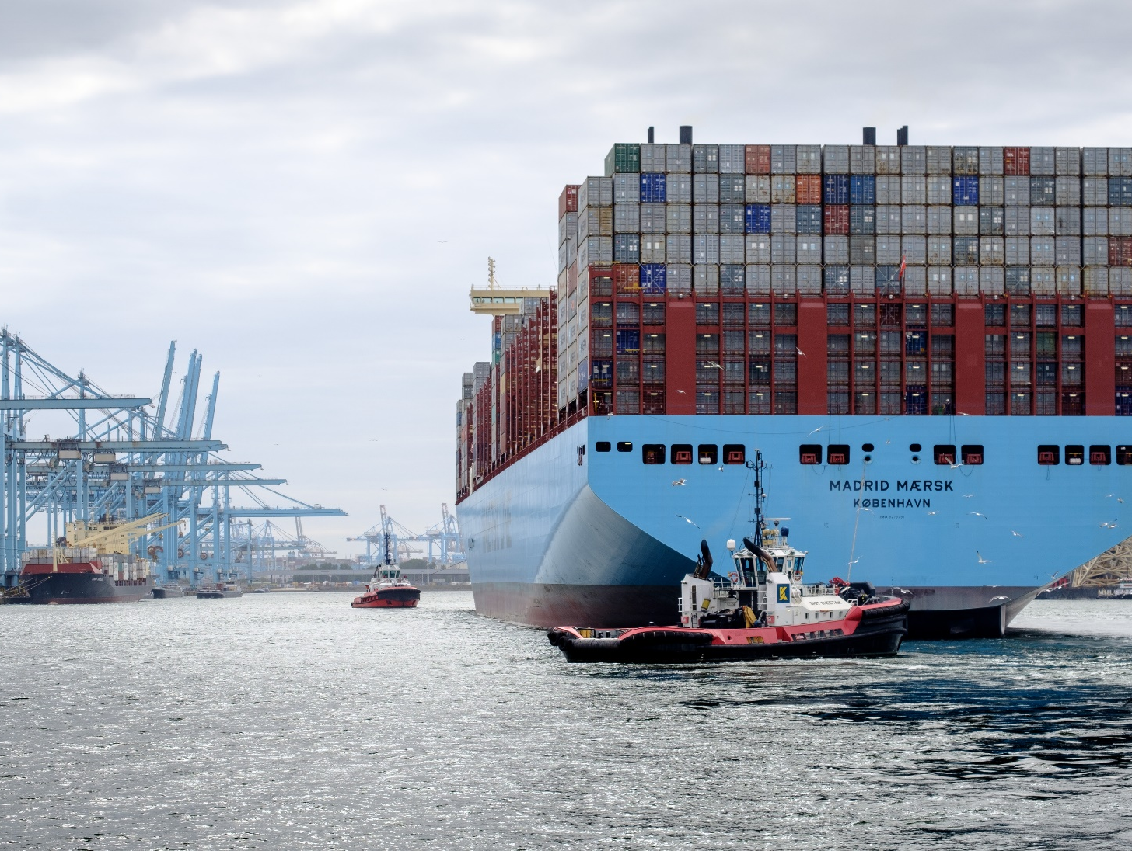
WHY ROTTERDAM?
The gateway to and from Europe
Reliable & Flexible
Fast & Efficient
Safe & Sustainable
Smooth end-to-end flow

Slide 4
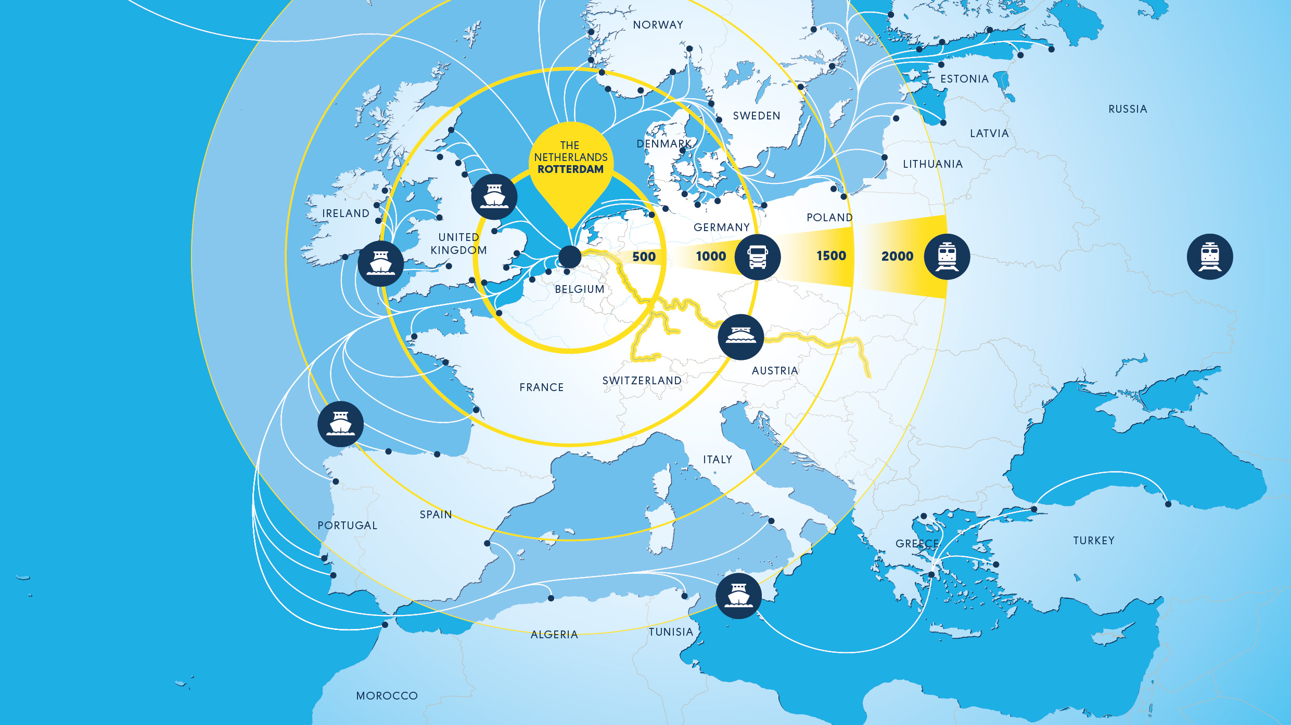
GATEWAY TO EUROPE & GLOBAL CARGO HUB
30 MILLION
CONSUMER WITHIN TWO HOURS
160 MILLION
CONSUMERS WITHIN EIGHT HOURS
500 MILLION
CONSUMERS WITHIN 24 HOURS
Notes:
Not only is the port of Rotterdam the largest port in Europe, it is also market leader in dry bulk, liquid bulk and container handling. The port mainly owes this position to the economies of scale Rotterdam offers. Not a single port in the Hamburg – Le Havre area is able to receive the largest dry bulk, liquid bulk and container ships 24/7.

Slide 5
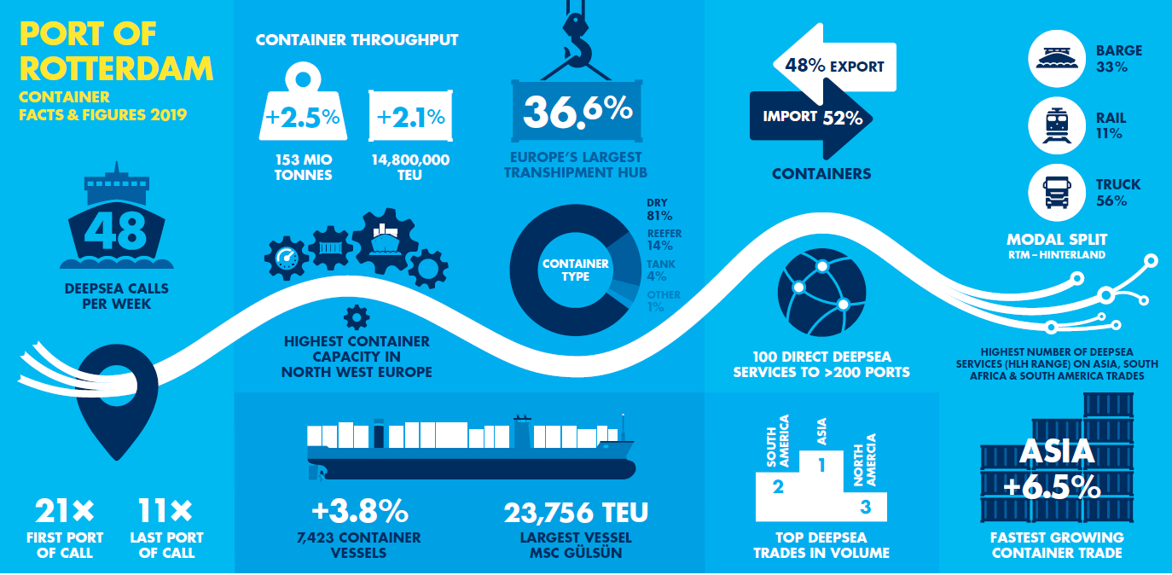

Slide 6
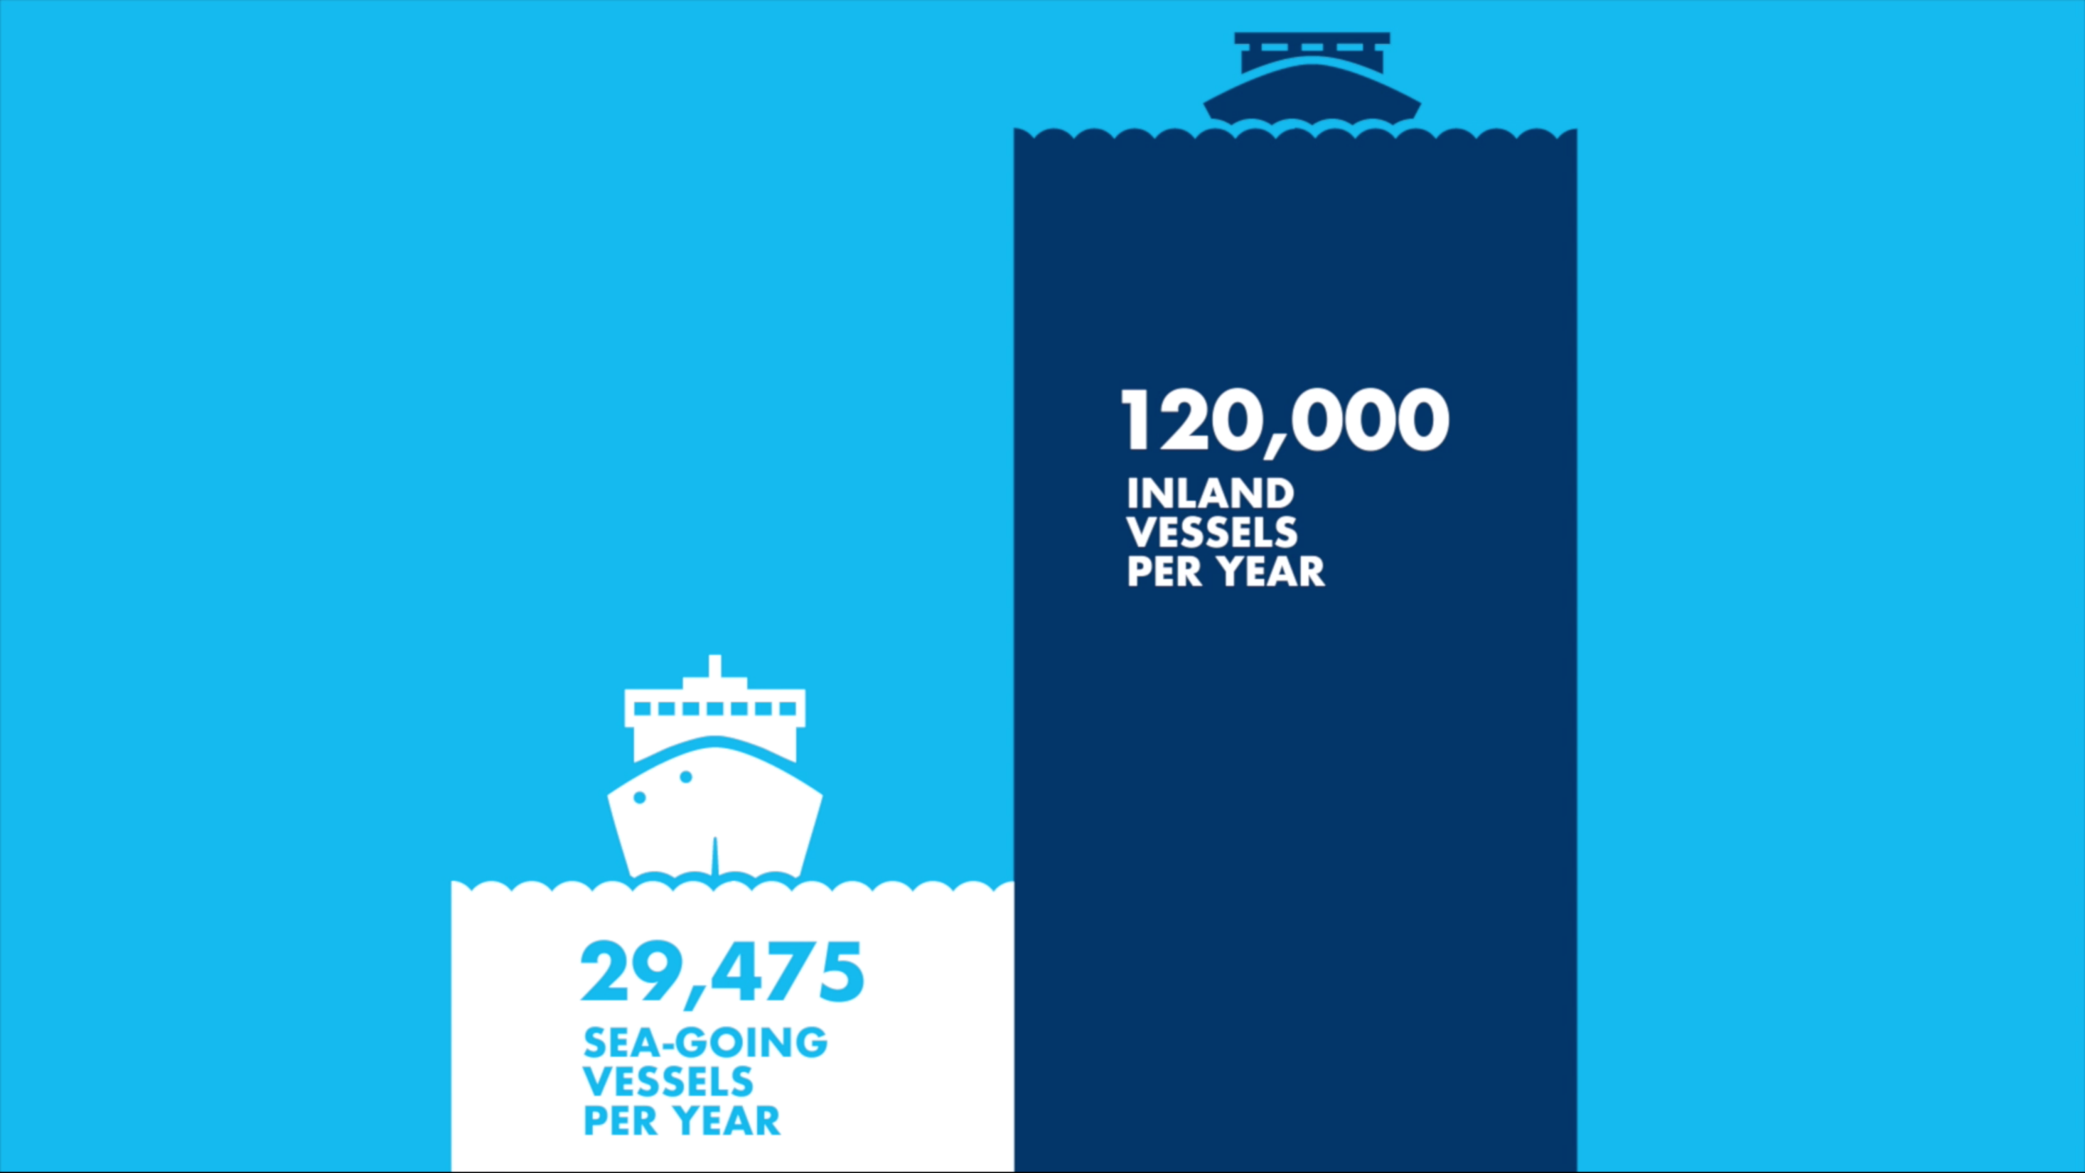
GATEWAY TO EUROPE
& GLOBAL CARGO HUB

Slide 7
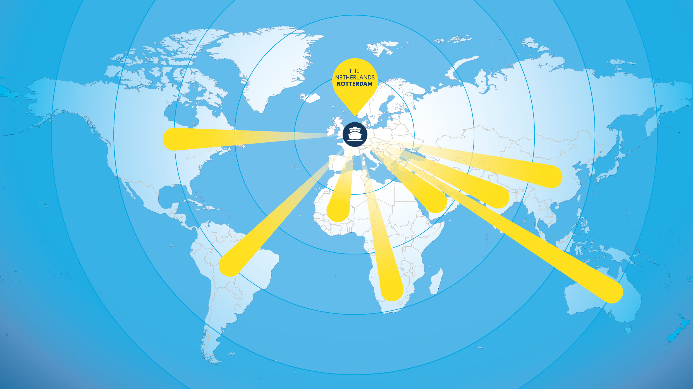
EXTENSIVE WORLD WIDE
DEEP SEA NETWORK – DIRECT SERVICES
100 DIRECT
DEEPSEA SERVICES
TO > 200 PORTS

Slide 8
EUROPE’S PREFERRED
TRANSHIPMENT HUB
Rotterdam
Antwerp
Hamburg
Bremerhaven
Weekly full container services per port (Source eeSea; PoR analysis 2020)
Notes:
Rotterdam has the highest amount of unique containers services per week in Europe
Rotterdam performs significantly better than competing ports if you look at the total network offered by the weekly services.

Slide 9
Container throughput on the rise
5 years in a row
2015
2016
2017
2018
2019
In TEU per year

Slide 10
ROTTERDAM ACCOUNTS FOR 60% OVERALL GROWTH HAMBURG-LE HAVRE RANGE
  Yearly throughput HLH-range has grown from 41,6 mln TEU in 2016 to 45 mln TEU in 2018
  Over 2 mln TEU of the extra
  3,4 mln TEU have been handled in Rotterdam
  Thereby Rotterdam took 60% of this overall growth
  Total HLH figures 2019 not yet finalised (will follow soon)
TEU (x 1.000) since 2016
Notes:
In absolute termen groeide Rotterdam in 2018 (780k+) méér dan Antwerpen (+/- 650k). Groei Antwerpen in tonnen (+6,4%) resp in TEU (+6,2% naar 11,1 miljoen).

Slide 11
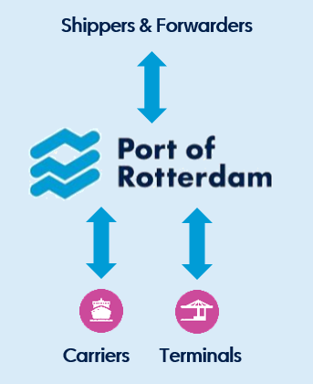
WHY ROTTERDAM?
Unique role of the port authority
Port of Rotterdam has a unique position:
Not a direct part of the supply chain but we know all parties
Neutral position towards supply chains
Relevant data for supply chain optimisation
Enabler in bringing parties together
Providing added value in:
  Matchmaking
  Building data positions
  Initiating, innovating and investing
  Co-creation of (digital) supply chain solutions

Slide 12
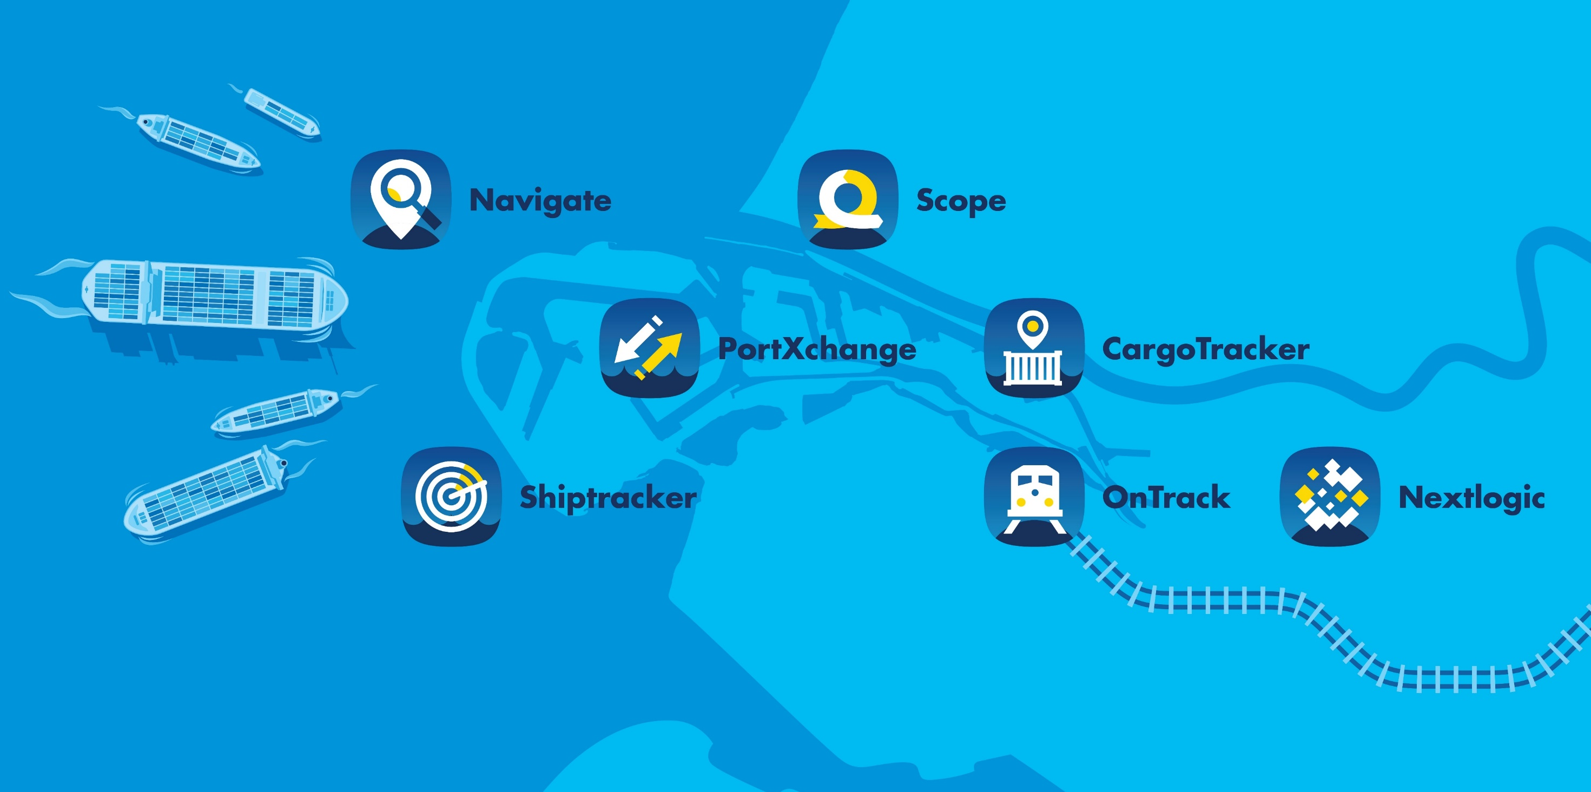
Optimising supply chains through digitisation
Notes:
Broadly speaking, the digitisation initiatives of the Port of Rotterdam Authority move along two axes. Although the distribution is not entirely black and white, on the one hand, there are projects in which a better administration and management of the port and port infrastructure are paramount; the internal core processes, as it were. On the other hand, there are processes that mainly require better insight into or the efficiency of logistics processes. In these processes, the added value and competitive position of Rotterdam play a more prominent role. In both areas, the applications developed can lead to international applications, whether or not on a commercial basis. After all, digital services can be used in ports and logistics chains worldwide from the coast to the hinterland. This results in new revenue streams and revenue models for the Port of Rotterdam Authority (which are developed and operated under the name PortForward).​

Slide 13
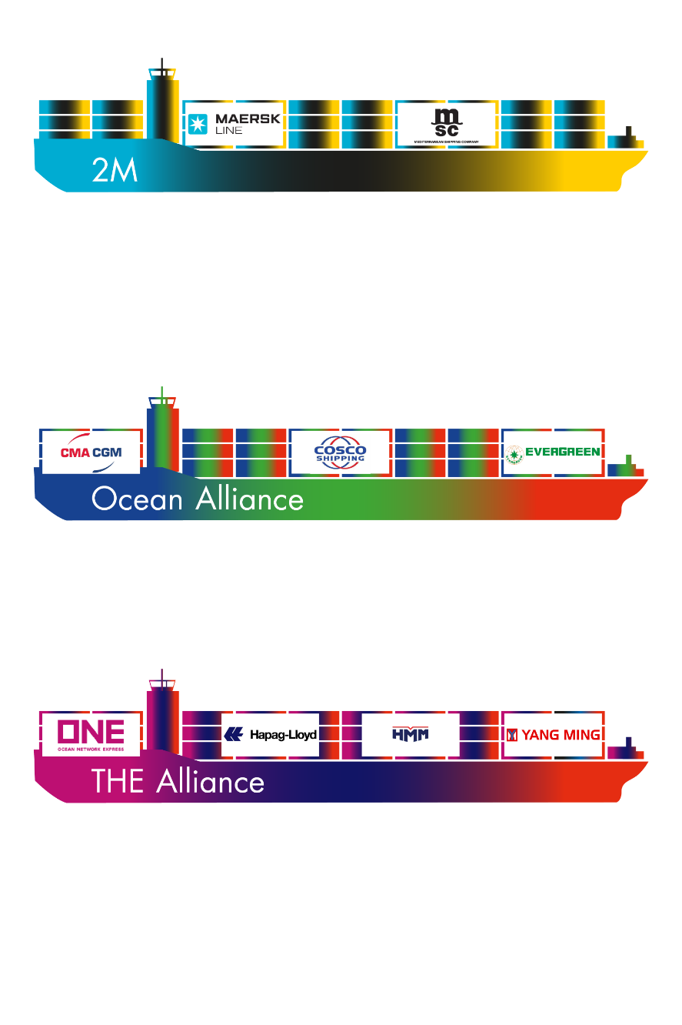
DEVELOPMENTS DEEPSEA CONTAINER MARKET
Scaling up fleet capacity and market share
Rotterdam often first / last port of call
High commitment between carriers and terminals in Rotterdam
Shift from shipping company to logistics company
Fleet investments under IMO 2020
Digital solutions on cost efficiency and customer excellence
More use of transshipment in Rotterdam

Slide 14
ALLIANCE PER
DEEP SEA TERMINAL
APMT-R
2M
ECT Delta Terminal
The Alliance
2M
Euromax
Ocean Alliance
Terminal | Ha | Capacity (mln. TEU) | Cranes | Reefer plugs
ECT Delta | 272 | 5,8 | 38 | 3,250
Euromax | 84 | 2,3 | 16 | 1,776
APMT-R | 100 | 3,35 | 14 | 2,250
APMT-MVII | 86 | 2,7 | 10 | 3,600
RWG | 108 | 2,35 | 14 | 1,700
APMT-II
2M
RWG
The Alliance
Ocean Alliance

Slide 15
SHAREHOLDERS PER
DEEP SEA TERMINAL
ECT Delta Terminal
Hutchison Port Holdings
NYK line (4,5%)
Employees (2%)
APMT-R
APM Terminals
Euromax
ECT: 65%
COSCO: 35% (Ocean Alliance)
APMT-II
APM Terminals
Maersk Line (2M)
RWG
DP World 30%
MOL: 20% (The Alliance)
HMM: 20% (slot charter with 2M)
CMA-CGM*: 30% (Ocean Alliance)

Slide 16
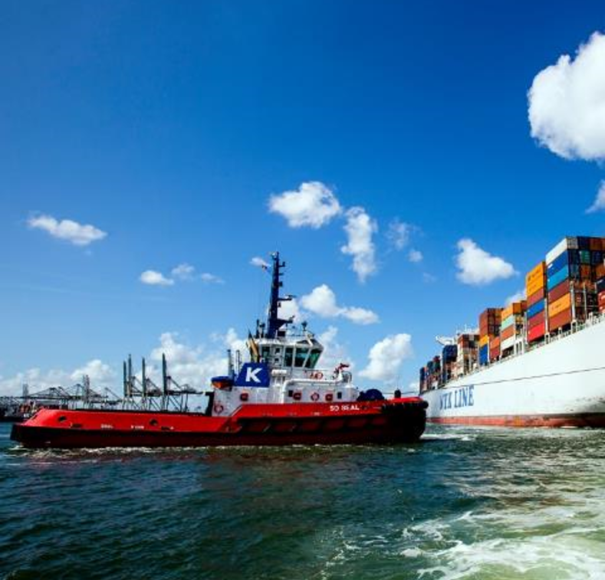
IMPACT OF LARGER CALL SIZES what does this mean for logistics?
Seaside growth:
  23,000 TEU vessel (load/discharge in Europe: 40,000 TEU)
  Call size Rotterdam: 10,000 TEU → 6.000 MOVES
  Modal split: rail=8% / barge=28% / road=34% / feeder=30 %
Hinterland traffic:
RAIL
800 TEU equals
10 trains
BARGE
2,800 TEU equals 28 barge calls
ROAD
3,400 TEU equals 2,000 trucks
FEEDER
3,000 TEU equals 5 feeder calls

Slide 17
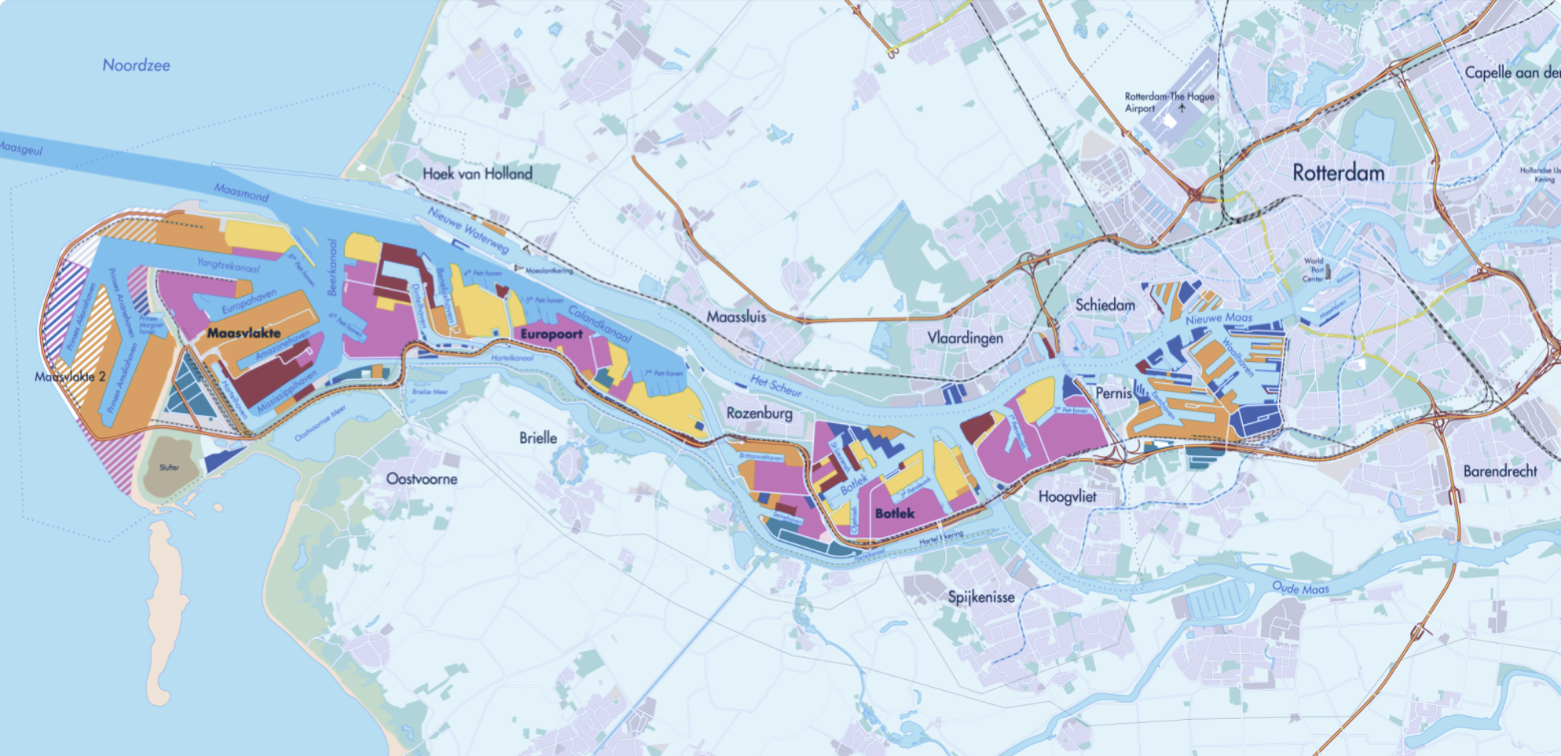

WAREHOUSING & DISTRIBUTION
Eemhaven
Segments Logistics, ADR, Agrofood, consumer goods
Large customers Eurofrigo, Geodis, Prologis
Plots issued 2017: 36 ha (88 ac)
Maasvlakte
Segments Consumer goods, Agrofood, ADR
Large customers Kloosterboer, Neele-Vat, Nippon, Prologis, Dudok
Plots issued 2017: 105 ha (259 ac)
Botlek
Segments Chemical, ADR, construction, logistics
Large customers DB Schenker, De Rijke, Pacorini, Steinweg, KBC
Plots issued 2017: 84 ha (207 ac)
100 Ha
(247 ac)
New Development

Slide 18
24/7 SAFE, EFFICIENT & RELIABLE ACCESS
WITHOUT LOCKS
Port | Max. Draft at Terminal | Open sea to Berth
Rotterdam Maasvlakte | 19.65 m | 2 hrs
Hamburg | 16.00 m | 6 hrs
Antwerp | 17.00 m | 6 hrs
Bremerhaven | 16.50 m | 12 hrs
4,800 TEU
Draft 13.50 m
8,000 TEU
Draft 14.50 m
≥ 23,000 TEU
Draft 19.65 m
Notes:
The Port of Rotterdam is accessible 24/7 for deep drafted vessels. The draft of the biggest container vessels is 16 m but they can only enter the ports of Antwerp and Hamburg at high tide and often not fully loaded. That’s why the Port of Rotterdam is often first and last port of call

Slide 19
Water depth European ports
Amsterdam
Antwerp
Bremerhaven
Hamburg
Le Havre
Vlissingen
Wilhelmshaven
Rotterdam
APM S-Class & HPL HAX-Class
Malacca-max

Slide 20
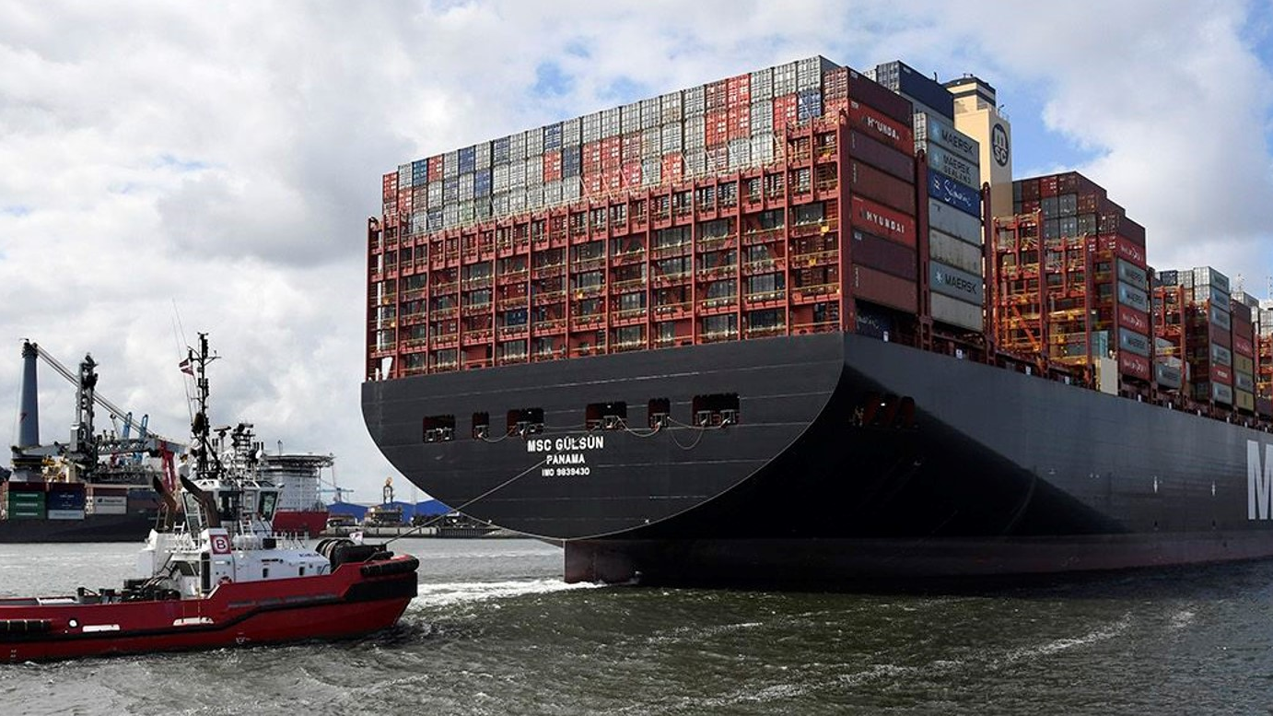
MSC GÜLSÜN – 23,756 TEU, 400 x 62 METER

Slide 21

Port of Rotterdam, the fastest route to freshness
Our ingredients for success:
Warranty of freshness
Short transit times due to our extensive deep-sea and shortsea network, dedicated agrofood facilities and our location in the midst of the perishable trade and production areas in the Netherlands.
Futureproof
The Port of Rotterdam can handle any type of vessel, from conventional reefer vessels to world’s largest container vessels. And there is room for growth: the Rotterdam Food Hub has 30 ha land available for businesses in the fresh and frozen food industry.
Efficiency and transparency
With our highly automated terminals, digital track & trace solutions and supply chain collaborations, we ensure a transparent logistics process, to deliver or collect your fresh or frozen products in the most efficient way.

Slide 22
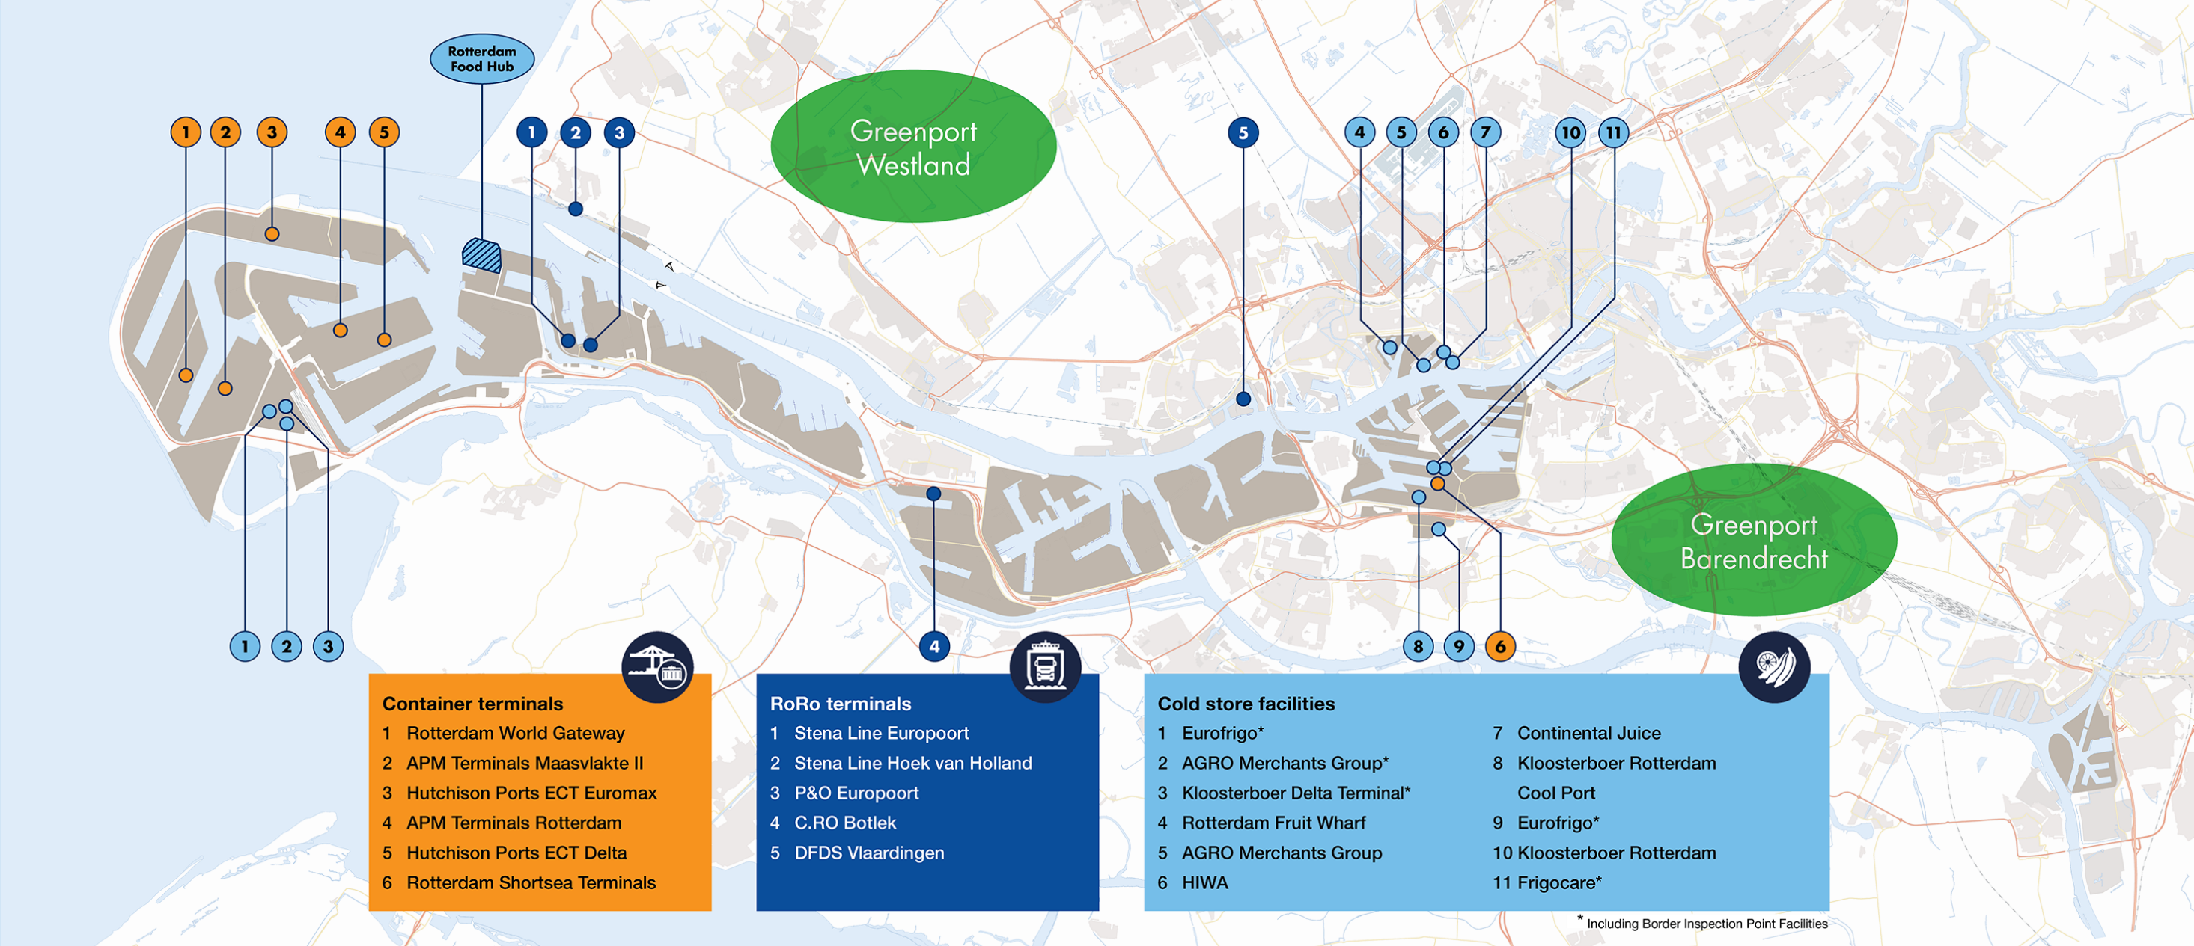
Agrofood facilities in Rotterdam
Notes:
The Netherlands has a renowned reputation in horticulture and agriculture industry, ranging from production, product innovation, new technologies, seed improvement and packaging technologies. Furthermore, there are various leading universities that focus on nutritional technology and logistics.
Most activities related to the production, import, export, distribution, transport and these value-added services are clustered in six areas in the Netherlands, the so-called Greenports. The port of Rotterdam is very favorably located in relation to the Westland and Barendrecht Greenports and has excellent intermodal connections with other Greenport areas, such as Venlo.
Agro Merchants, Nicherei and Kloosterboor currently hold the 4th, 5th and 6th position of the largest refrigerated warehouses. All 3 have 2 or more locations in the various parts of the port, and are even expanding their capacity as we speak.
At the Maasvlakte, most facilities are used for frozen products like french fries, meat and fish. Fresh fruit is mostly being stored at Cool Port, Rotterdam Fruit Wharf and Agro Merchants (M4H).
The M4H also holds 2 locations dedicated to juices and juice concentrates. Cutrale’s import terminal Continental Juice, handles a yearly 500.000 tonnes of orange juice, which comes in tanker vessels from Brazil. CJ has a market share of 50% in the European import of juices.
Every year 250.000 to 300.000 tons of fruit juices, fruit juice concentrates and fruit purees packed in drums and bins and destined for Europe are being handled, stored and processed at HIWA in Rotterdam. HIWA's total storage capacity is more than 100.000 tons.

Slide 23
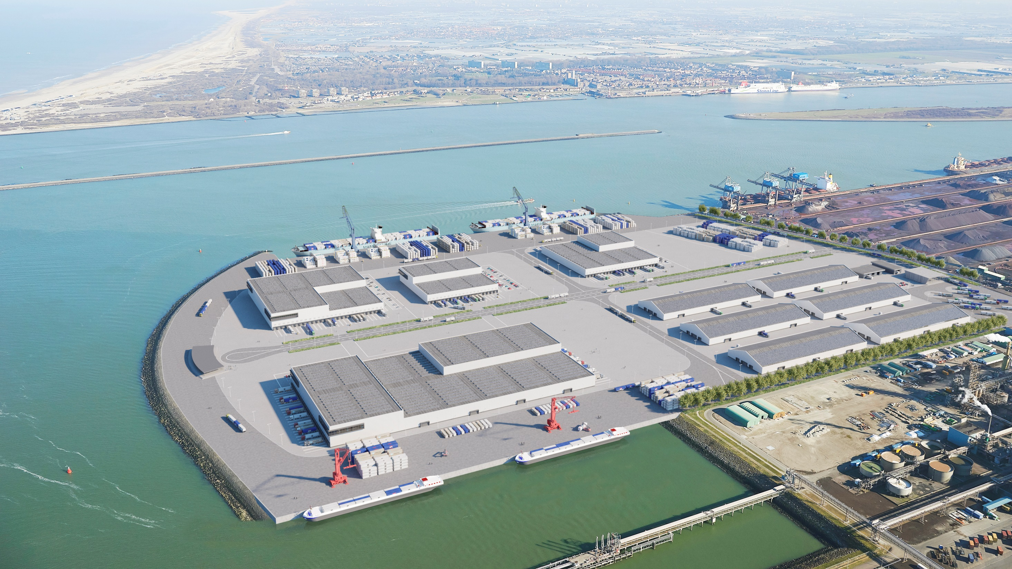
Rotterdam Food Hub
      A dedicated location in the Port of Rotterdam with an optimal logistics infrastructure and unique nautical facilities, where various businesses in the fresh and frozen supply chain would like realize their growth ambitions.
AFBEELDINGEN ARTIST IMPRESSION
      Thanks to the shared use of facilities, synergy benefits can be achieved that will enable fast handling of products and reduce logistic costs.

Slide 24
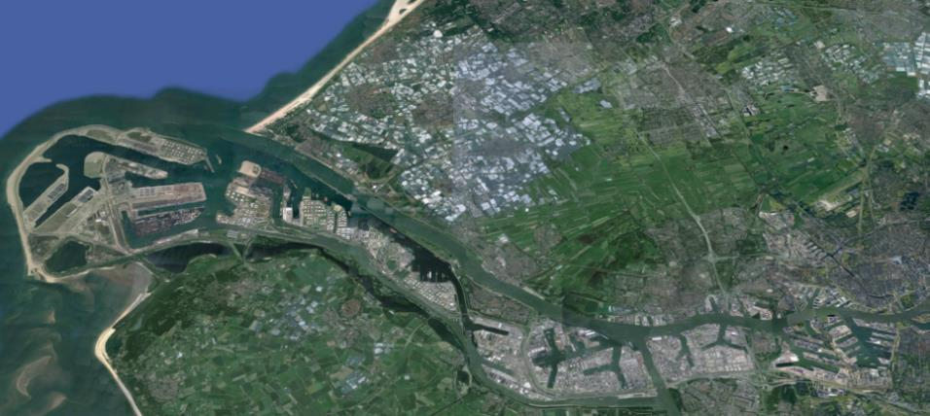
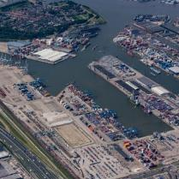
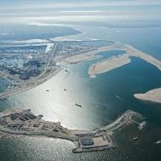
DEDICATED
CONTAINER CLUSTERS
MAASVLAKTE
Deepsea
WAAL- & EEMHAVEN
Shortsea

Slide 25
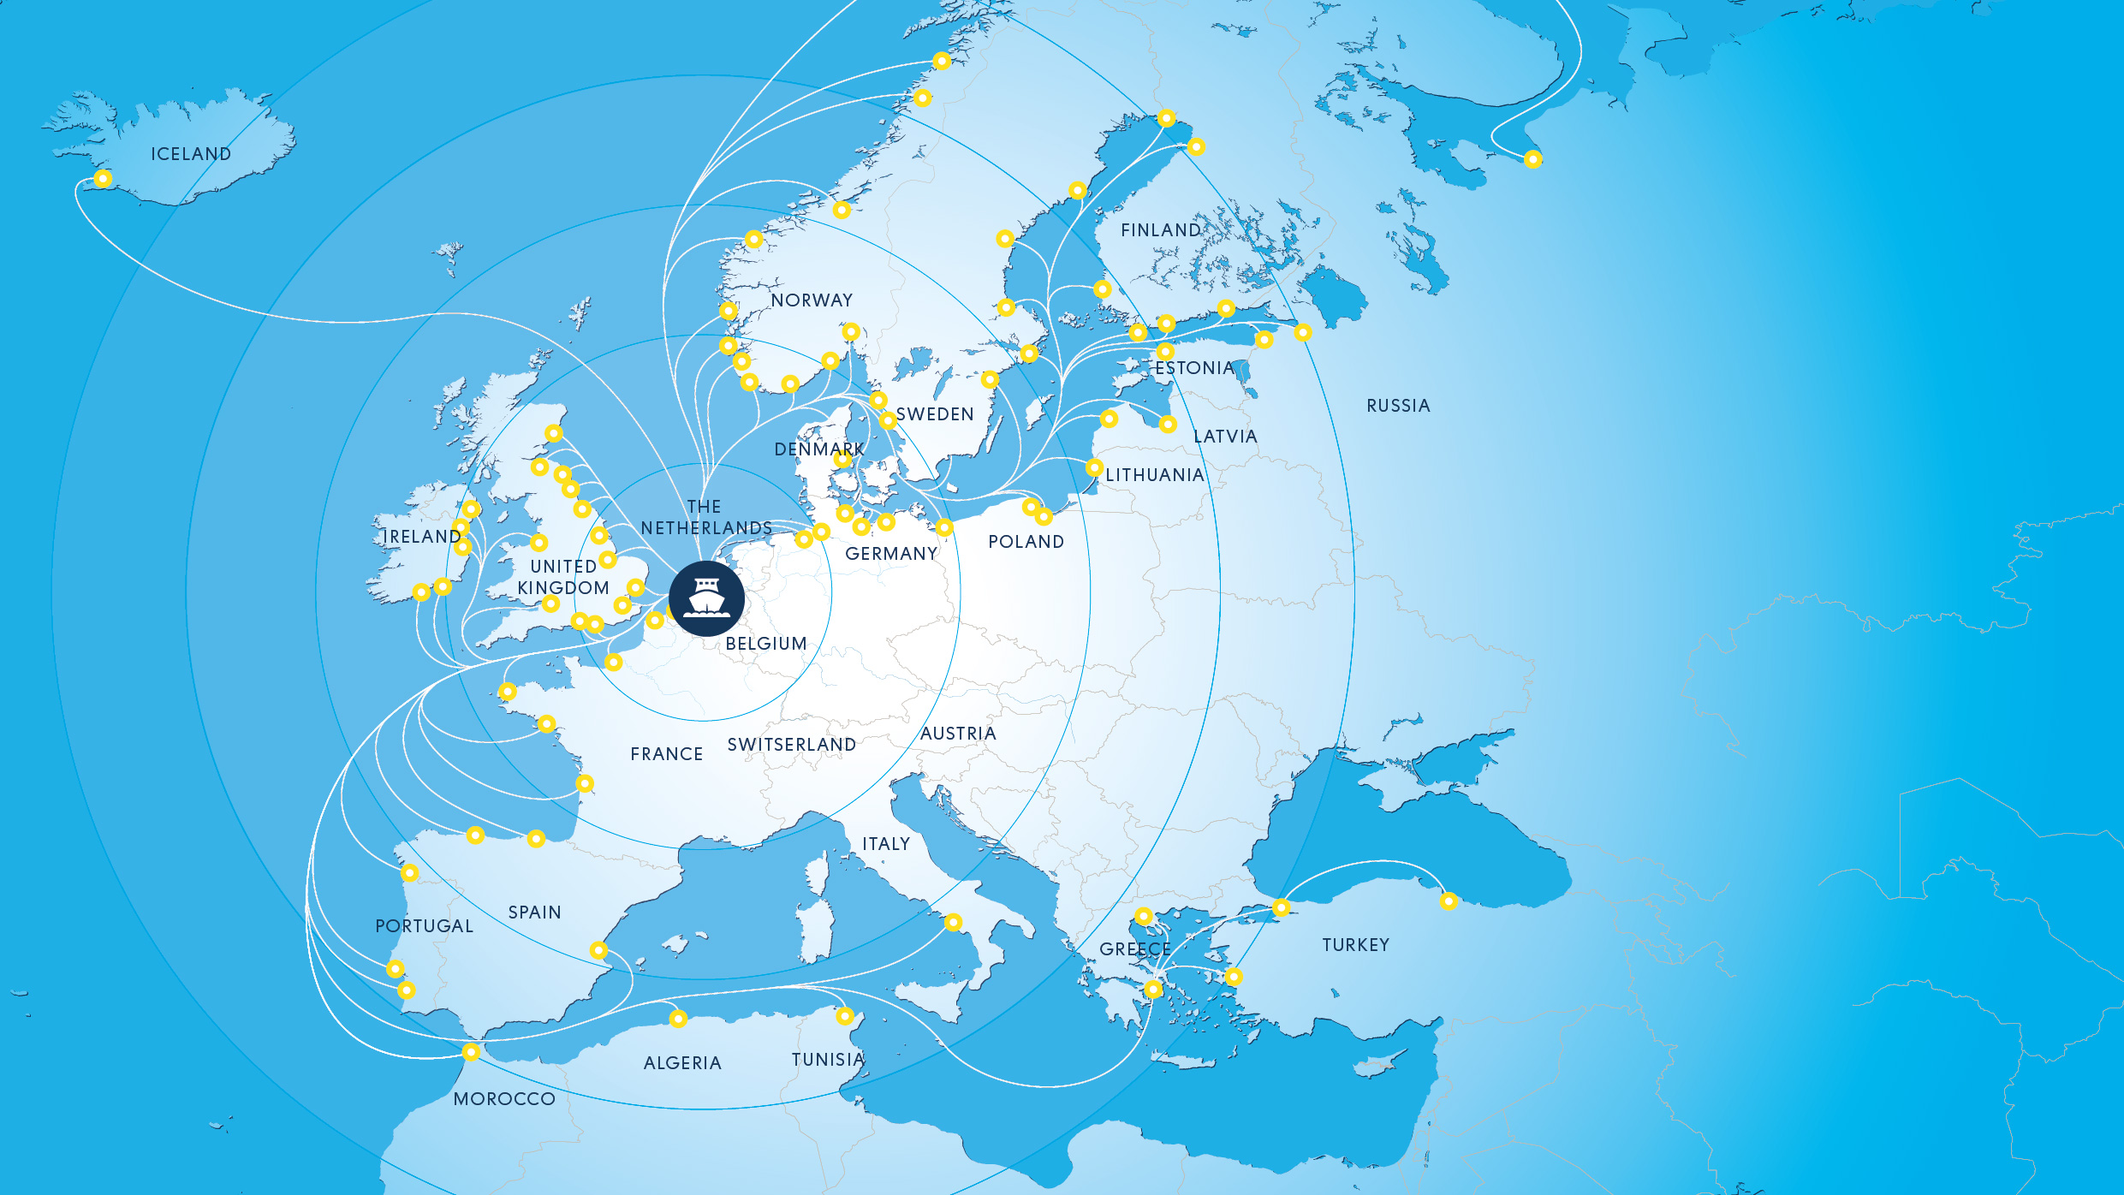
COMPETITIVE SHORT SEA NETWORK
More than 150 weekly services connect the port of Rotterdam with the rest of Europe

Slide 26
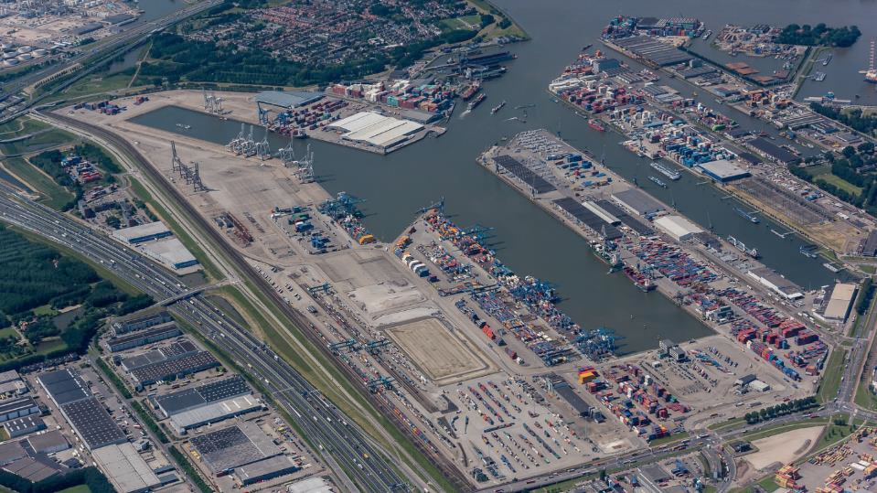






EEMHAVEN - SHORT SEA
REEFER CENTER
DEPOT
Forest PRODUCTS
SHORTSEA
EMPTY
HANDLING
Shortsea CONTAINERS
REEFERSERVICE CENTER
SHORTSEA
A15
SHORTSEA
RAIL
COOL PORT
CENTRAL Gate
CROSSDOCK
RAIL
PHASE 1

Slide 27

SMART DIGITAL INFRASTRUCTURE:
PORT COMMUNITY SYSTEM
Largest port community in Europe
Wide coverage throughout the chain:
    90.000.000 messages
    > 4.500 companies
    > 40 services
    15.500 users
Digital connection and service provider between all parties involved
A one-stop-shop for logistic information exchange
Notes:
Portbase connects all parties in the logistics chains of Dutch ports.
The Port Community System transcends the ports and has a broad basis of support in the port community.
Supply Chain Specific benefits:
One-stop-shop for automated information exchange
All governments and related processes are connected
Use of standard messages and procedures throughout the ports
Low administration costs due to automation
Information flows reach both governments and business well in advance of vessel arrival
Better government inspections due to timely and correct data, thus improving transit times
Sharing/ re-use of data improves data quality

Slide 28
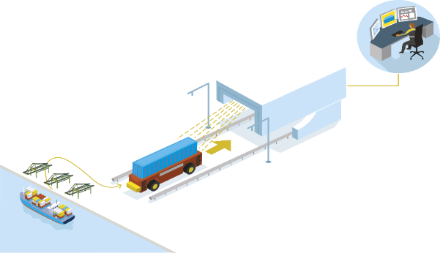




DUTCH CUSTOMS
FACILITATING A SMOOTH SUPPLY CHAIN
Rotterdam is an ideal starting point for importing into and exporting from Europe. Dutch Customs is responsible for releasing goods that enter or leave Europe via Rotterdam and is known to be one of the most efficient customs departments in the world.
24/7
Up to 4hrs time saving
50% cost savings
Scanning time of an Automated
Guided Vehicle (AGV) on the
Maasvlakte: 10 minutes.
High-tech scanning equipment

Slide 29
DUTCH CUSTOMS
EFFICIENCY AS A KPI
The Netherlands: best overall performer in trade facilitation (119 countries). Source: UNESCAP, 2016
Pro-business attitude: partners with private sector
Electronic submission of import and export documents
‘Single Window’ and ‘One Stop Shop’ concepts
RELATIONSHIP
TRUST
AEO-certificate,
priorities and privileges.
RISK
TARGETED APPROACH
Implementing the customs risk management framework
to better target the checks.
SERVICES
Always operating in interest
of client.
COOPERATION
I.e. joint investments customs and private sector, joint risk analysis, partnerships.

Slide 30
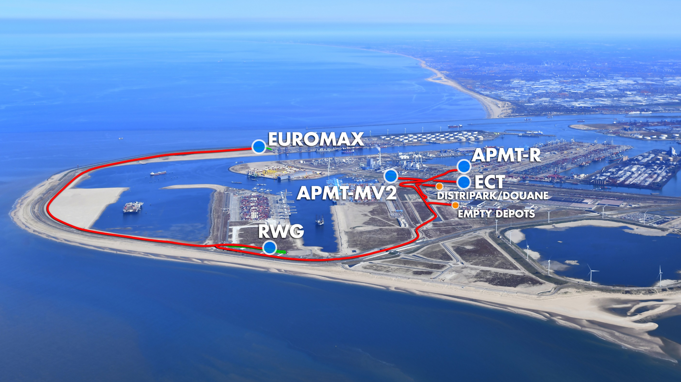
CONTAINER EXCHANGE ROUTE
SMOOTH BUNDLING & EXCHANGE OF CONTAINERS

Slide 31



PORTSHUTTLE
CONTAINER EXCHANGE BY RAIL

Slide 32
ATTRACTIVE CASH FLOW ADVANTAGE
VAT DEFERMENT

Slide 33
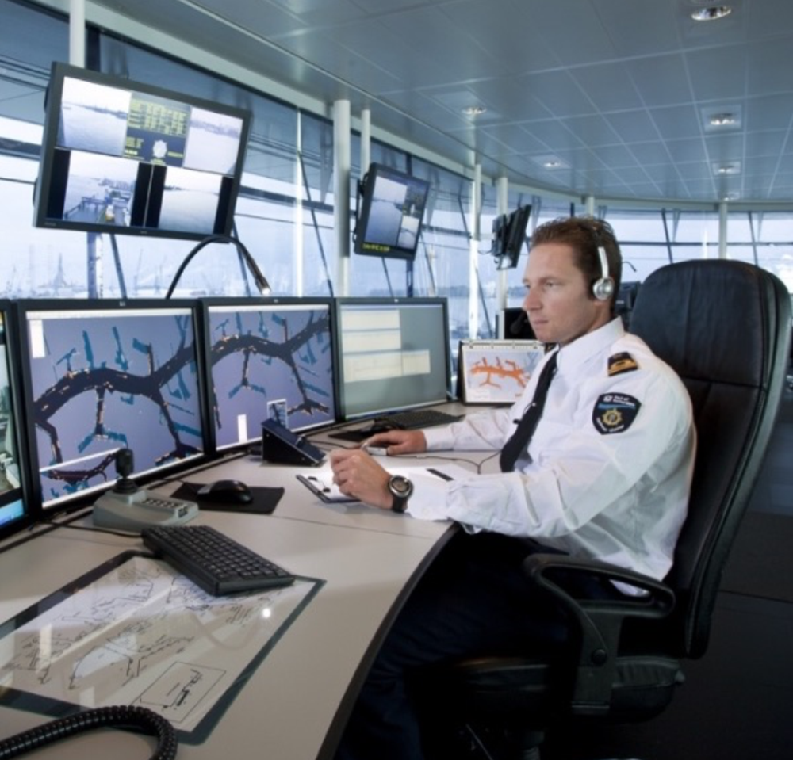
SAFETY FIRST
The Port of Rotterdam Authority works to ensure that the port and its environs remain safe, healthy and attractive. Safety is our number one priority in the port. And not just for local shipping, but also for residents, people working in the port, companies and professional and recreational users of the port area. Safety is a very broad concept. It can relate to social safety, water safety, workplace safety and cybersecurity.

Slide 34
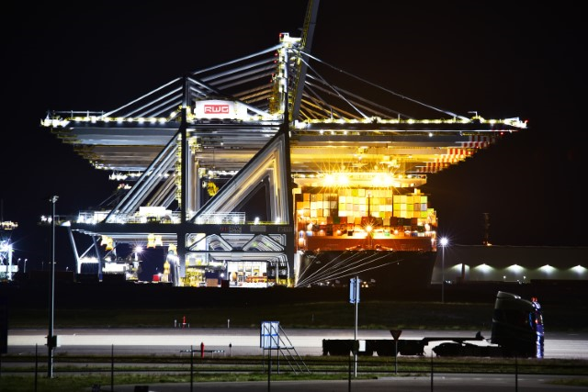
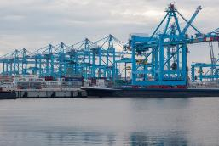
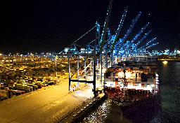
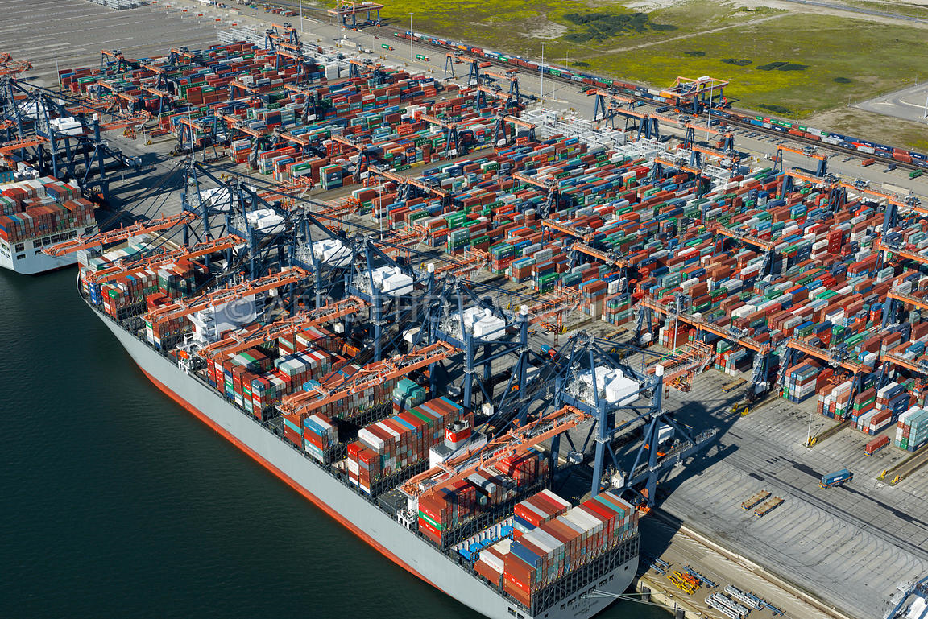
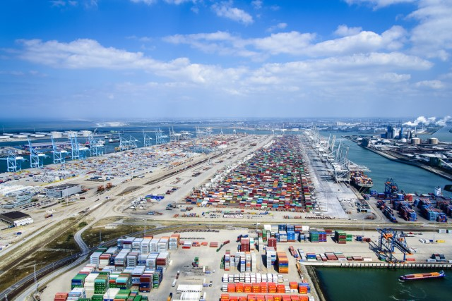
5 SUSTAINABLE, SAFE & STATE OF THE ART
DEEP SEA TERMINALS
Highly efficient operations to minimize environmental impact
Battery powered Automated Guided Vehicles (AGV) transport of containers around the terminals for up to eight hours
ECT Delta: first fully-automated terminal in the world
APMT-II: world’s first zero emission terminal for CO2, NOx and particulates
RWG: fully electric and CO2 neutral terminal
Sustainable hinterland connections through dedicated barge quays and onsite rail terminals

Slide 35
A HIGHLY SKILLED AND Motivated WORKFORCE
The Netherlands’ workforce is highly educated as well as motivated and flexible.
The Netherlands is one of the most multilingual nations in Europe
Labor productivity, measured as GDP per hour worked, is above average.
More than 800,000 logistics professionals
source: European Commission, Eurobarometer: Europeans and their Languages, 2012

Slide 36
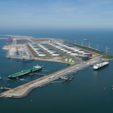
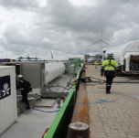
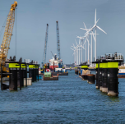
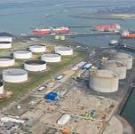
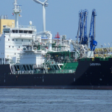
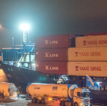
FRONTRUNNER IN ENERGY TRANSITION
TIMELINE
GATE
TERMINAL
TRUCK TO BARGE
BUNKERING
LNG DOLPHINS
GATE BREAK
BULK FACILITY
FIRST LNG
BUNKER VESSEL
TRUCK TO
SHIP BUNKERING
2011
50/50 Vopak/Gasunie
3x180.000 m3
2 Jetties
Vessels >7.000 m³
2011
Truck-to-Barge bunkering
Location : Seinehaven
2015
Ship-to-Ship Transfer
Ship-to-Ship LNG bunker
LNG Priority
EU Funded
2016
Loading and re-export
Vessels and (bunker) barges < 7.000 m³
2017
Capacity 6.800 m³
Operat. & owned by Shell
> 6 bunker vessels by 2020
2018
Multiple truck-to-ship bunkering
Open access
Location: Waalhaven

Slide 37






CO2 EMISSIONS IN TRANSPORT
23%
of global CO2 emissions
30%
caused by transport of goods
3%
by deep sea shipping
TRANSPORT
Source IMO 3rd GHG Study 2014

Slide 38
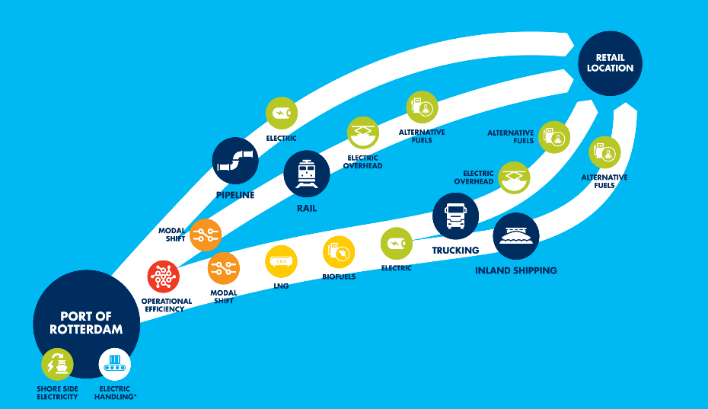
PATHWAYS TO
DECARBONISE TRANSPORT

Slide 39

THE WORLD’S BEST PORT INFRASTRUCTURE
The Netherlands was ranked first 6 times in a row
Country / Economy | Score (1-7)
Netherlands Singapore Hong Kong United Arab Emirates Finland | 6.8 6.7 6.5 6.2 6.2
Global Competitive Index 2017-2018, World Economic Forum.
HINTERLAND TRAFFIC

Slide 40
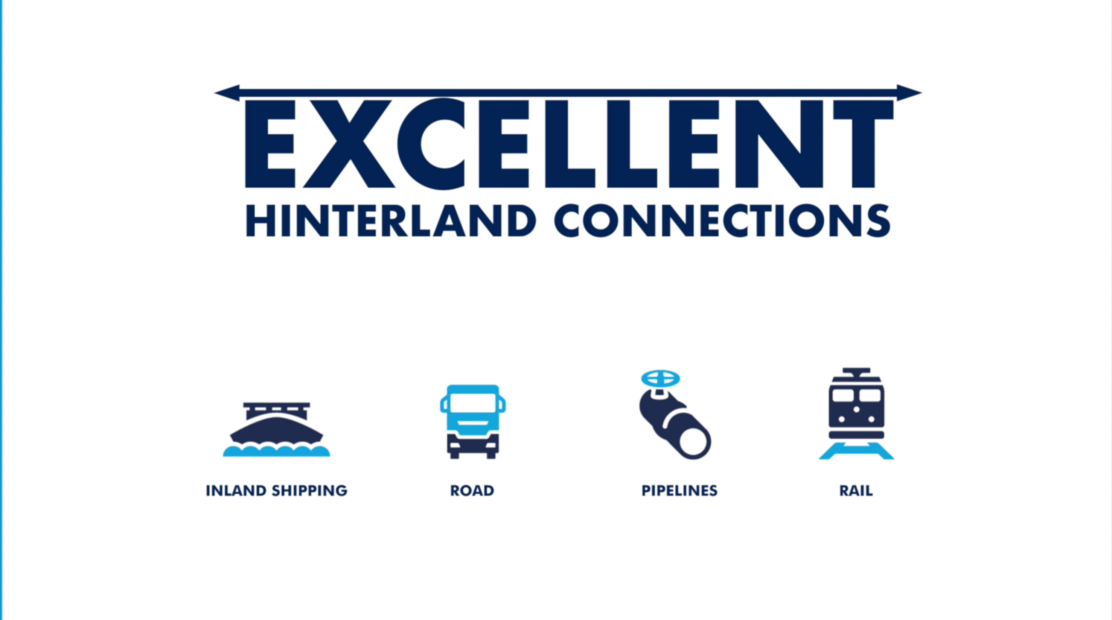

Slide 41
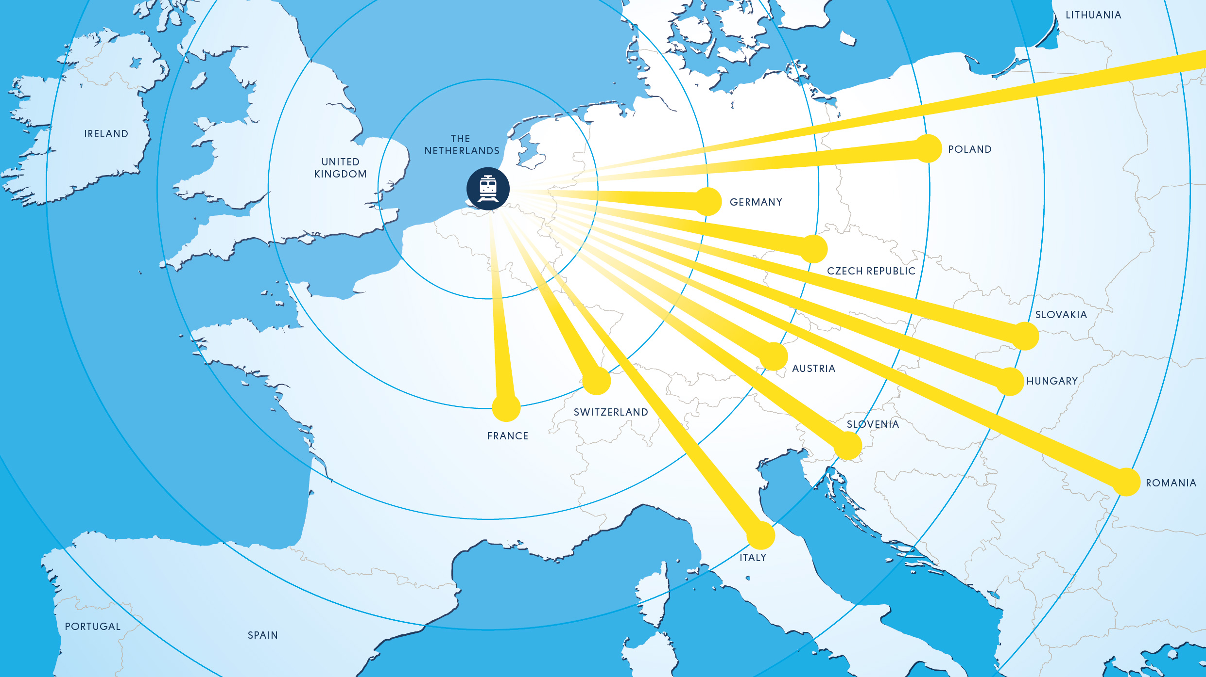
EXCELLENT RAIL CONNECTIONS
More than 400 weekly rail cargo services connect the port of Rotterdam with the rest of Europe
Notes:
Slide aanpassen
Is het mogelijk om de knooppunten van de BRI te benoemen en dat te linken
Duisburg
Venlo
Etc
Let op Nu lijkt het net een belgie slide

Slide 42
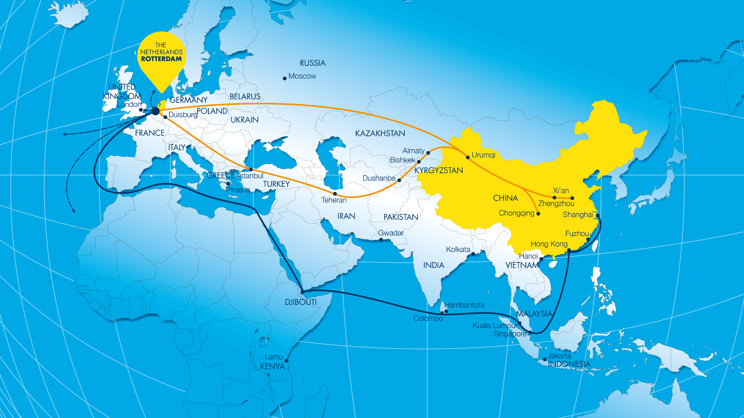
THE NEW SILK ROAD – OPPORTUNITIES FOR THE PORT OF ROTTERDAM
Already well connected
by rail via Duisburg, Tilburg & Venlo.

Slide 43
LOCATED AT THE MOUTH
OF THE RHINE AND THE MEUSE
Sustainable Transport
Optimised Inland Shipping
Nautical Links
Flexible Inland Shipping

Slide 44
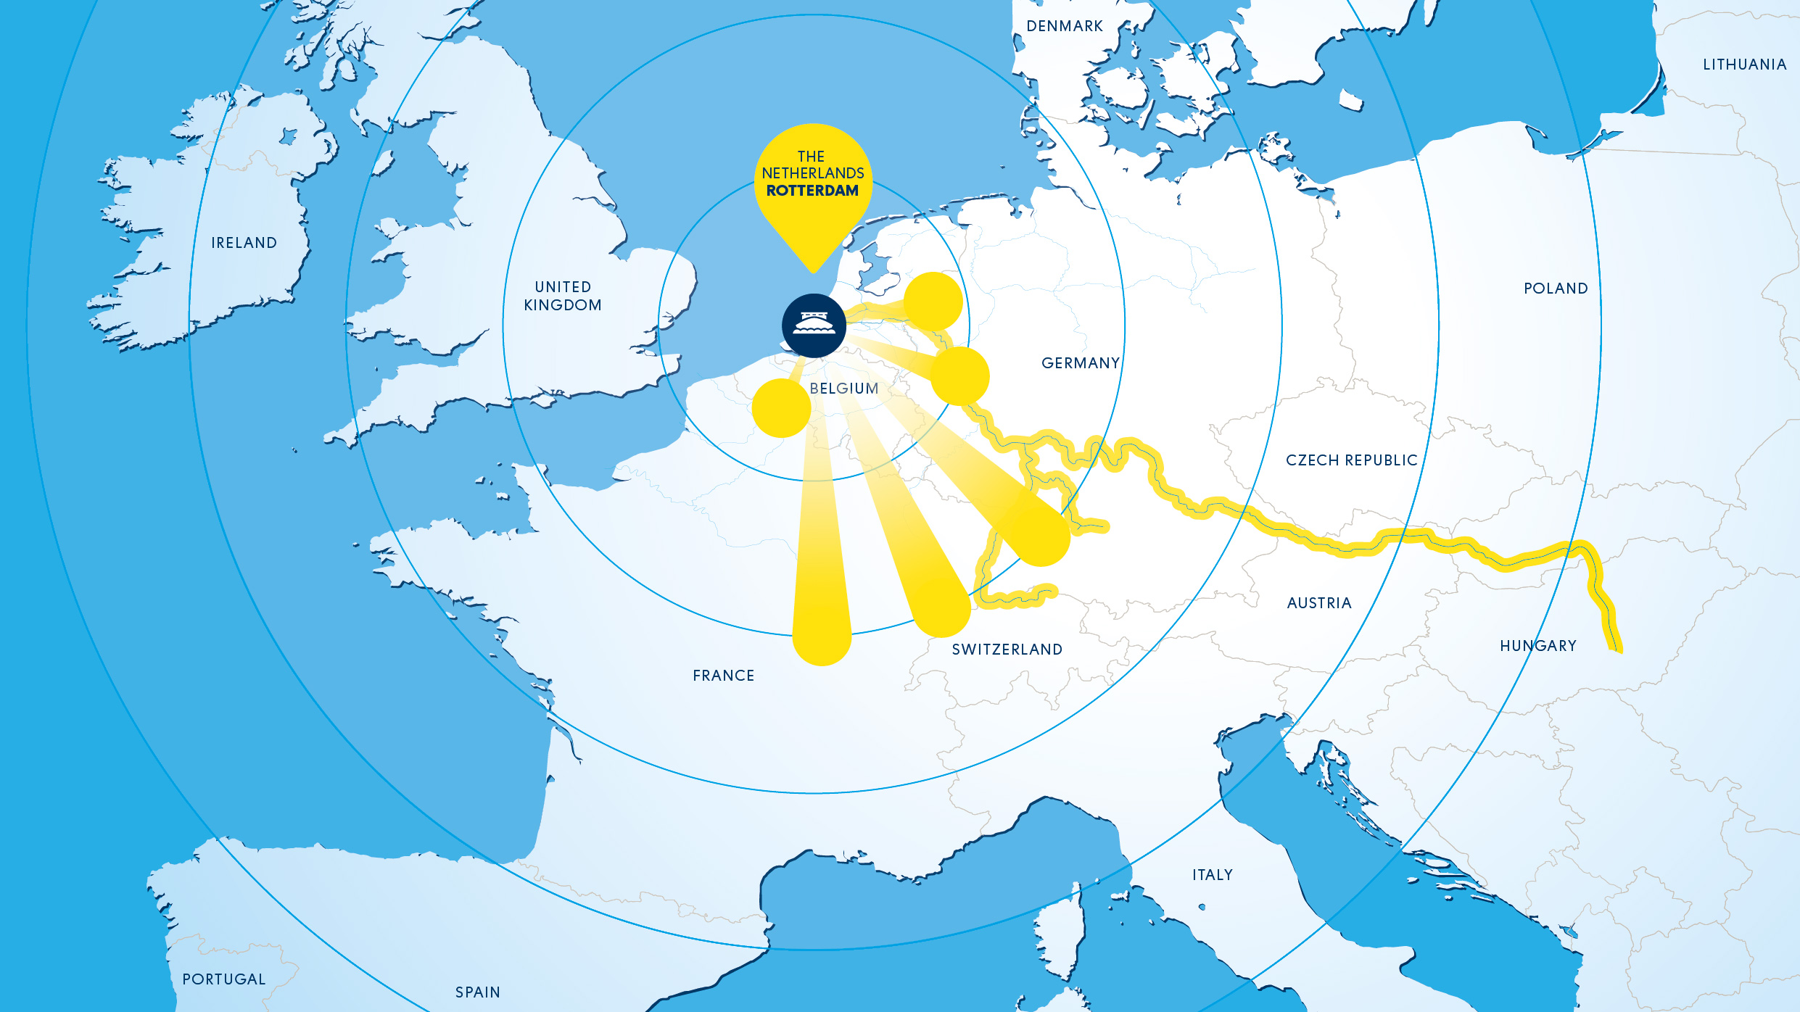
EXCELLENT BARGE
CONNECTIONS
More than 250 weekly barge services connect the port of Rotterdam with the rest of Europe

Slide 45
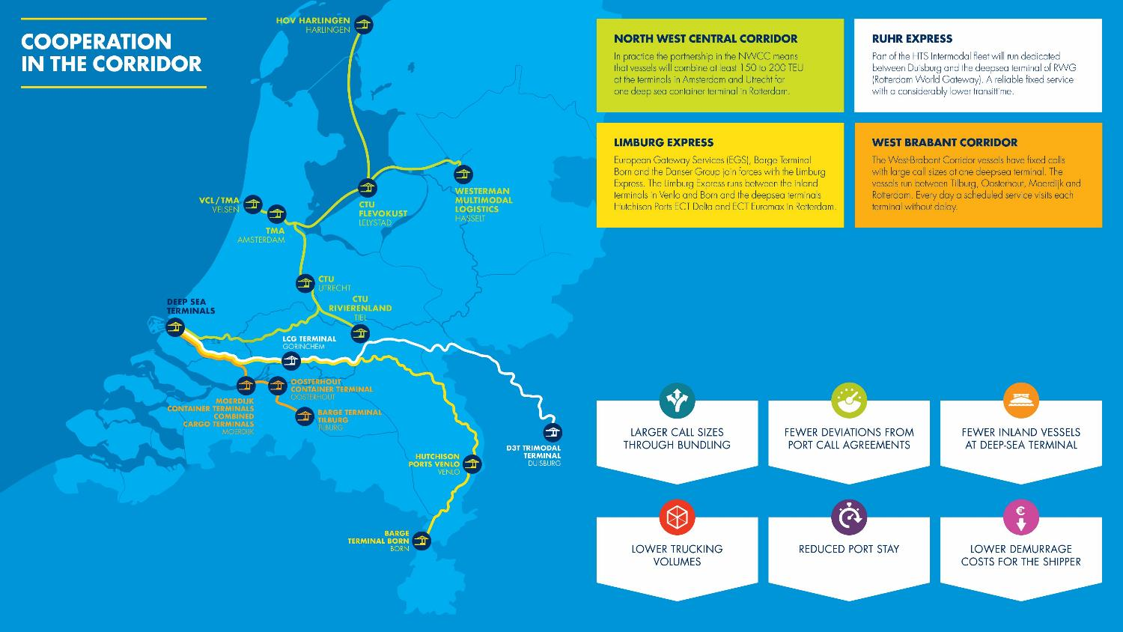

Slide 46
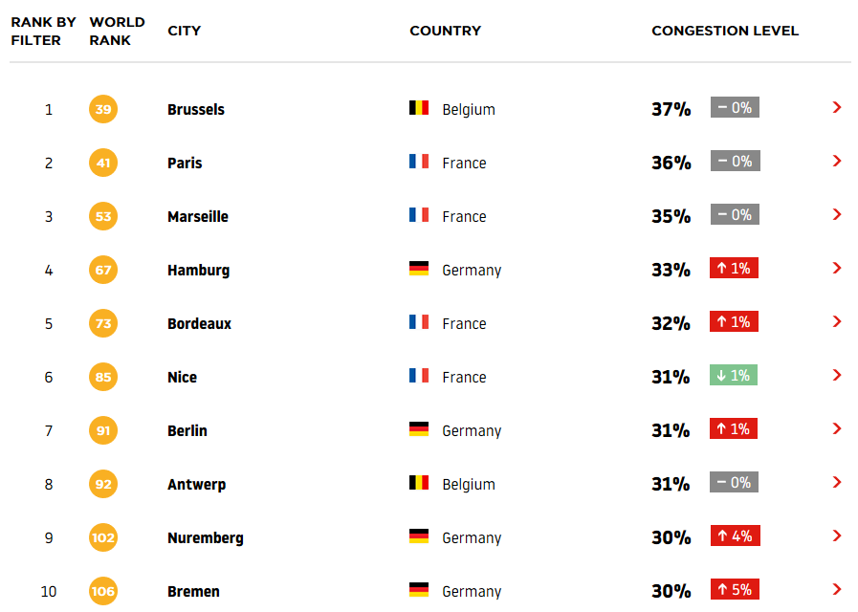
TRANSPORT BY TRUCK: FAST & FLEXIBLe
TOMTOM TRAFFIC INDEX 2018
Top 10 of most congested cities in
the Hamburg – Le Havre range
Rotterdam ranked at nr. 33
About 40% of containers transported from the port by road remains in the Rotterdam region.
Half of the freight is intended for the Dutch market, and only around 10% of freight traffic to and from the port of Rotterdam crosses the border.
Source: TomTom International BV

Slide 47
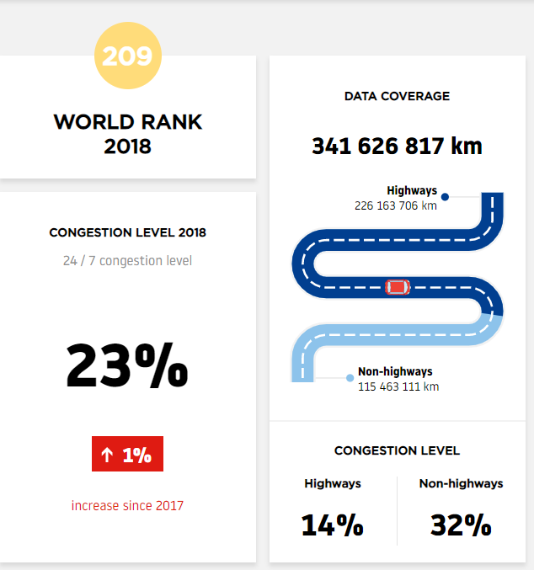
TRANSPORT BY TRUCK: FAST & FLEXIBLe
TOMTOM TRAFFIC INDEX 2018
Rotterdam scorecard
Road congestion in Rotterdam decreases
The degree of road congestion in the port of Rotterdam has been falling for years, partly as a result of the investments in infrastructure.
At the same time, the additional transport time in rival ports regions has been fluctuating, with no permanent downward trend.
Source: TomTom International BV

